Slide 1

ClassTECH
Webapp
student-friendly eclassroom website

Slide 2
01
02
03
Abstract
Features
Introduction
existing in thought or as an idea but not having a physical or concrete existence
List of features
Introduction about project

Slide 3

Abstract
In graduate studies, many students find it difficult to achieve good grades because they do not get much support in higher education courses compared to the support that students receive in schools. We can use machine learning for the student grades prediction task so that instructors can help students prepare for topics where student grades were predicted low.in this project, Face attendance system, Quiz, whiteboard , chatbot , timetable, books, notes etc.

Slide 4

“Teachers need to integrate technology seamlessly into the curriculum instead of viewing it as an add-on, an afterthought, or an event.”
—Keith Bachman

Slide 5
Introduction
Universities are very prestigious places to access higher education Some students need a lot of attention from instructors because if special attention will not be given to those students who are not getting good grades, it could be detrimental to their emotional state and their career in the long run. By using machine learning algorithms, we can predict how well the students are going to perform so that we can help the students whose grades are predicted low. Student Grades Prediction is based on the problem of regression in machine learning

Slide 6
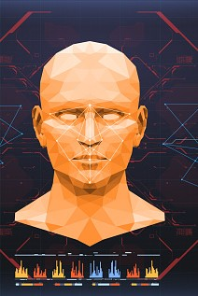
Face recognition
Facial recognition is a way of identifying or confirming an individual’s identity using their face. Facial recognition systems can be used to identify people in real-time.

Slide 7

Chatbot
Anyone who has been through school would relate to the struggle of balancing school work, social life and extracurricular activities. Here’s where chatbots come in: not only are they fun and engaging, they’re also really great tools to help you keep your busy life in check

Slide 8

Quiz Weekly

Slide 9

Student Performance
By using machine learning algorithms, we can predict how well the students are going to perform so that we can help the students whose grades are predicted low. Student Grades Prediction is based on the problem of regression in machine learning.

Slide 10

Feedback

Slide 11
Technologies
—Django
Backend
Frontend
— Reactjs
— Tailwind css
Database
Browser
—MySQL
— Any

Slide 12

THANKS!
Do you have any questions?
sohammanjrekar@eng.rizvi.edu.in
+91 7045208474

